Slide 1
Feature importance in the presence of correlated variables
Be aware of the shortcomings of interpretation methods to avoid false conclusions
Gabriele Maroni, PhD
Dalle Molle Institute for Artificial Intelligence
DTI, SUPSI
gabriele.maroni@idsia.ch
Notes:
In this tutorial session we will talk about feature selection techniques and feature importance techniques but at an intermediate level in the sense that I will assume you already know how these techniques work, although I will briefly review them. We will talk about an uncomfortable situation that afflicts practically all feature selection and importance methods as well as most of the datasets you will encounter in real life which is the presence of correlated features.
This tutorial is for who wants to use machine learning for scientific discoveries, to learn some techniques with their drawbaks

Slide 2
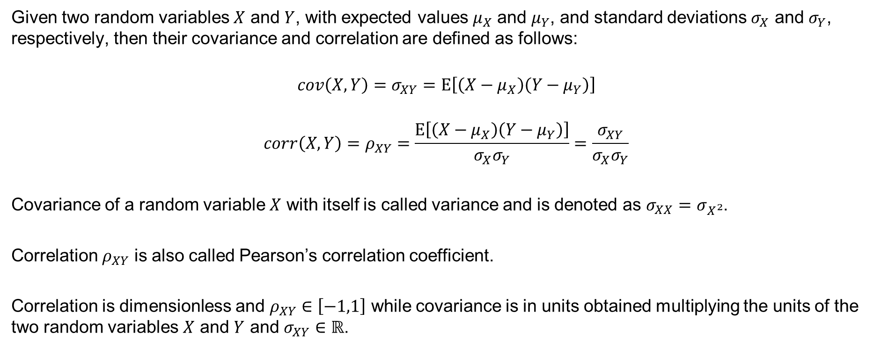
Covariance and correlation
Given two random variables $X$ and $Y$, with expected values $μ_{X}$ and $μ_{Y}$, and standard deviations $σ_{X}$ and $σ_{Y}$, respectively, then their covariance and correlation are defined as follows:
$$cov\left(X,Y\right)=σ_{XY}=E\left[\left(X−μ_{X}\right)\left(Y−μ_{Y}\right)\right]$$
$$corr\left(X,Y\right)=ρ_{XY}=\frac{E\left[\left(X−μ_{X}\right)\left(Y−μ_{Y}\right)\right]}{σ_{X}σ_{Y}}=\frac{σ_{XY}}{σ_{X}σ_{Y}}$$
Covariance of a random variable $X$ with itself is called variance and is denoted as $σ_{XX}=σ_{X^{2}}$.
Correlation $ρ_{XY}$ is also called Pearson’s correlation coefficient.
Correlation is dimensionless and $ρ_{XY}∈\left[−1,1\right]$ while covariance is in units obtained multiplying the units of the two random variables $X$ and $Y$ and $σ_{XY}∈ℝ$.

Slide 3
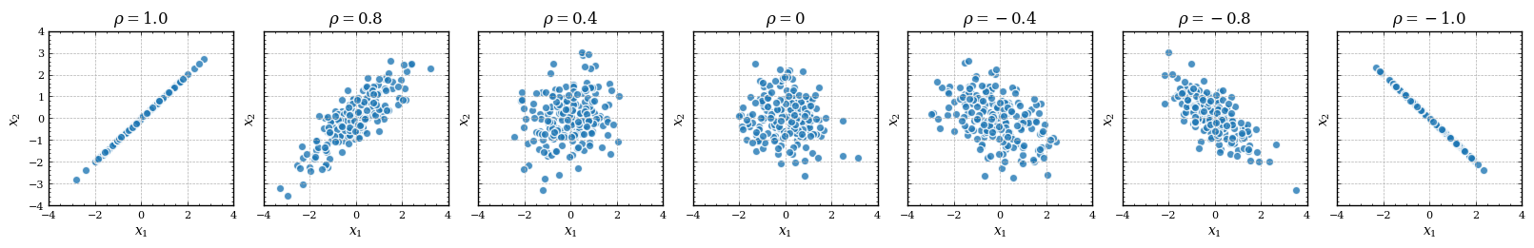
Visualizing correlation

Slide 4
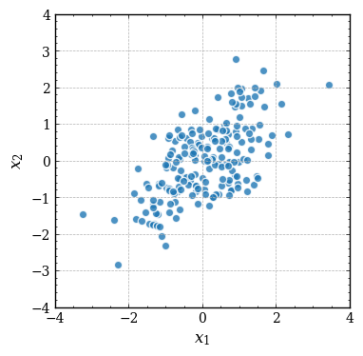
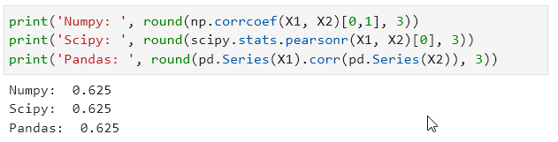
Computing correlation in python

Slide 5
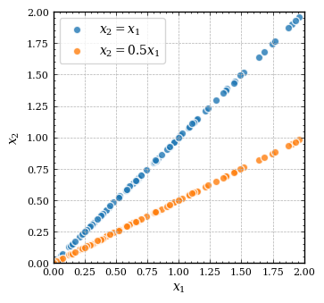
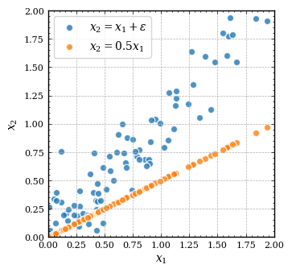
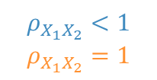
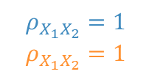
Quiz 1
Is the correlation stronger for blue or orange data points?
$$ρ_{X_{1}X_{2}}=1$$
$$ρ_{X_{1}X_{2}}=1$$
$$ρ_{X_{1}X_{2}}<1$$
$$ρ_{X_{1}X_{2}}=1$$

Slide 6
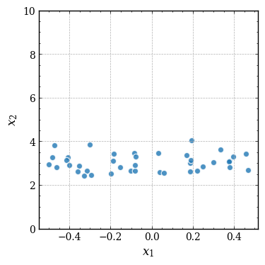
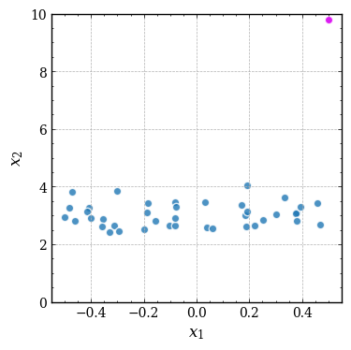


Correlation vs outliers
Correlation is very sensitive to outliers.
$$ρ_{X_{1}X_{2}}≈0$$
$$ρ_{X_{1}X_{2}}≈0.3$$

Slide 7
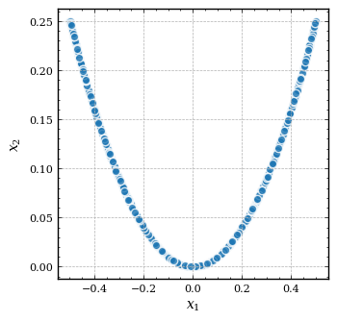
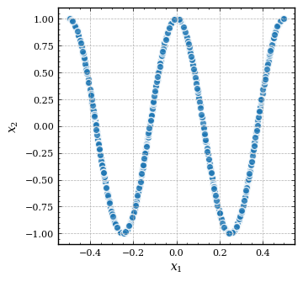
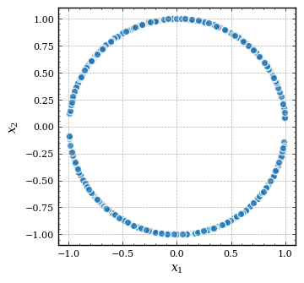
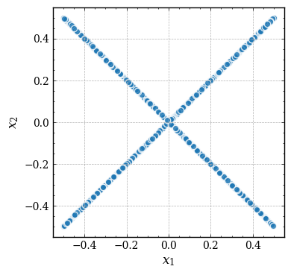
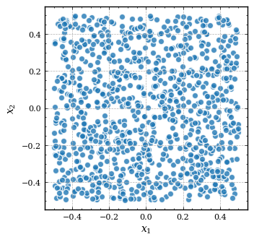





Quiz 2
Can you order in ascending order the following figures with respect to correlation strength?
A
B
C
D
E
$$ρ_{X_{1}X_{2}}≈0$$
$$ρ_{X_{1}X_{2}}≈0$$
$$ρ_{X_{1}X_{2}}≈0$$
$$ρ_{X_{1}X_{2}}≈0$$
$$ρ_{X_{1}X_{2}}≈0$$

Slide 8
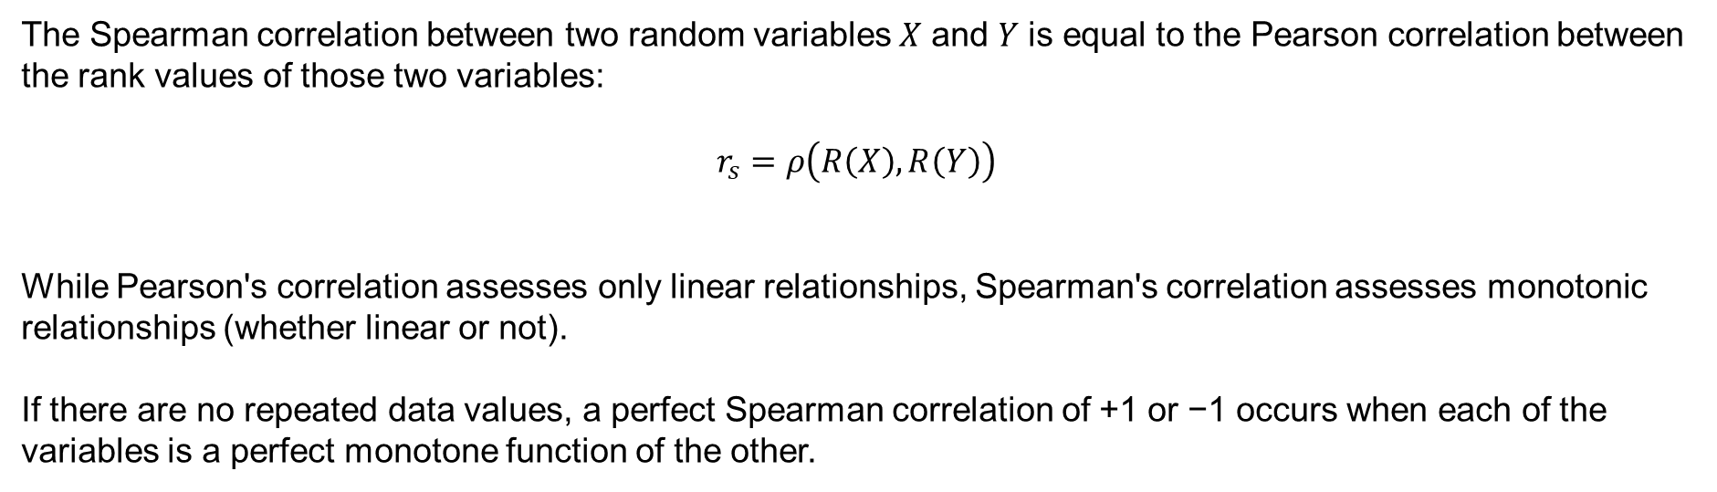
Spearman's rank correlation coefficient
The Spearman correlation between two random variables 𝑋 and 𝑌 is equal to the Pearson correlation between the rank values of those two variables:
$$r_{s}=ρ\left(R\left(X\right),R\left(Y\right)\right)$$
While Pearson's correlation assesses only linear relationships, Spearman's correlation assesses monotonic relationships (whether linear or not).
If there are no repeated data values, a perfect Spearman correlation of +1 or −1 occurs when each of the variables is a perfect monotone function of the other.

Slide 9
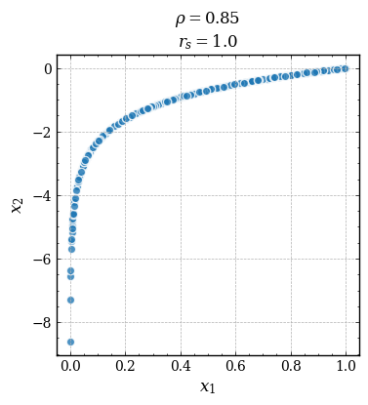
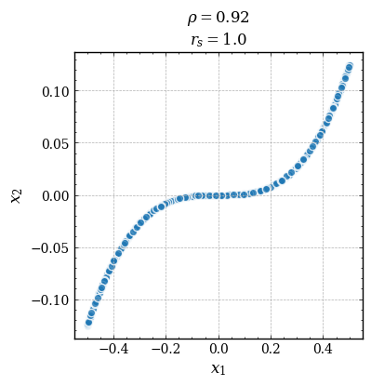
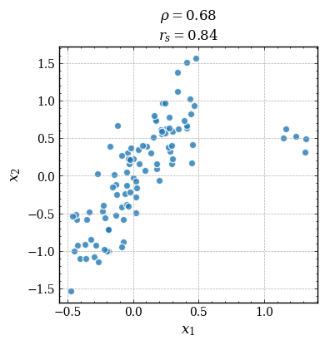
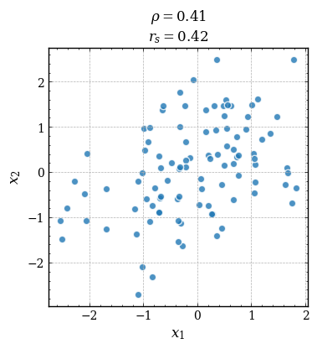
Visualizing Spearman correlation
More robust to outliers
With no outliers and “elliptical relationship” similar results to Pearson

Slide 10
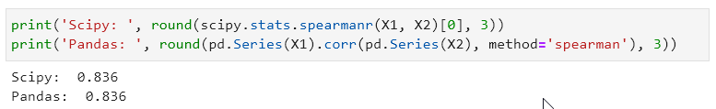
Computing Spearman correlation

Slide 11
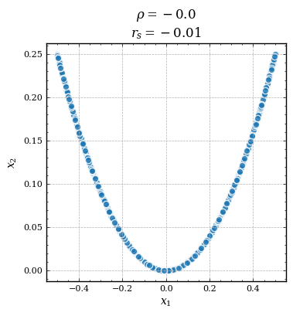
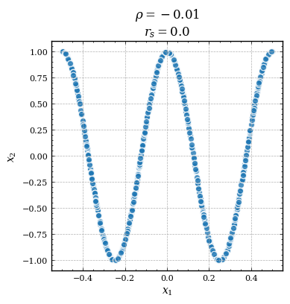
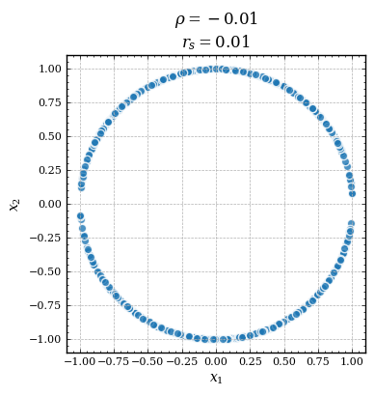
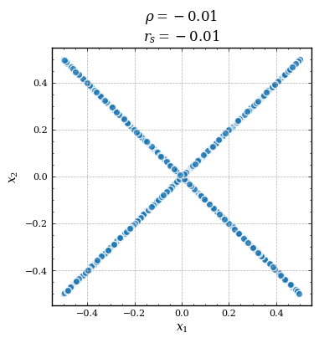
Spearman correlation is not enough

Slide 12
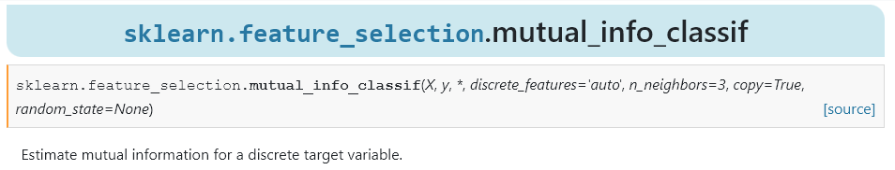
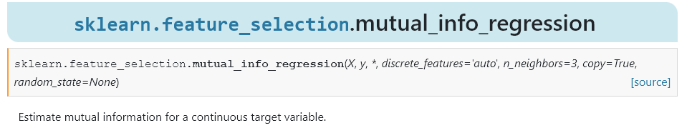
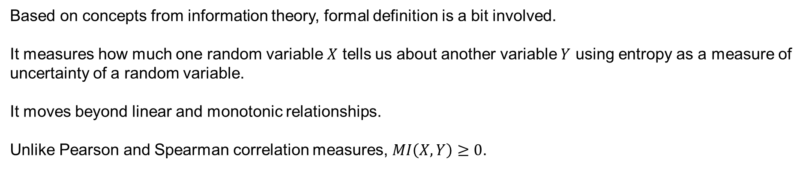
Mutual Information (MI)
Based on concepts from information theory, formal definition is a bit involved.
It measures how much one random variable $X$ tells us about another variable $Y$ using entropy as a measure of uncertainty of a random variable.
It moves beyond linear and monotonic relationships.
Unlike Pearson and Spearman correlation measures, $MI\left(X,Y\right)≥0$.

Slide 13
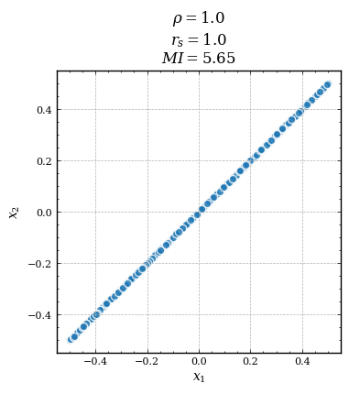
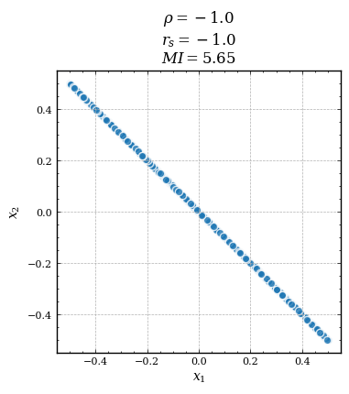
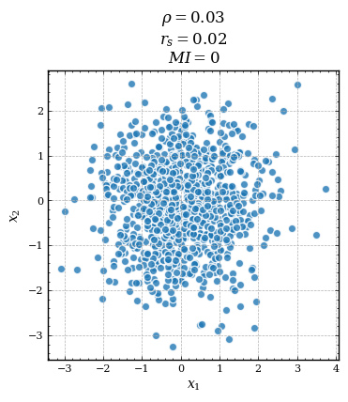
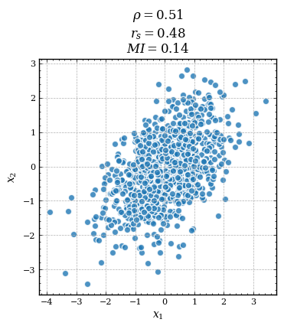
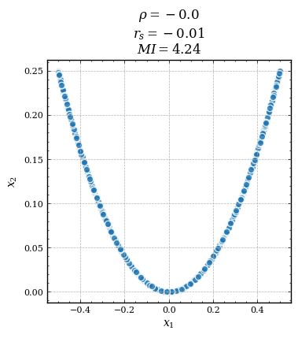
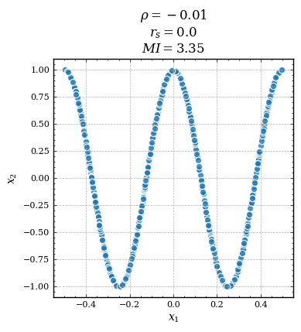
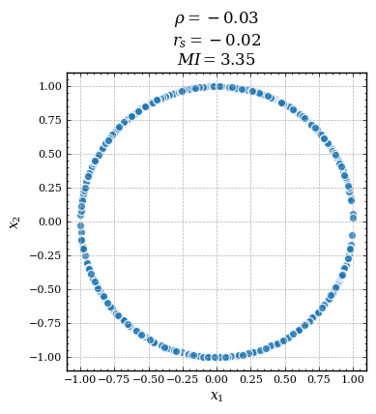
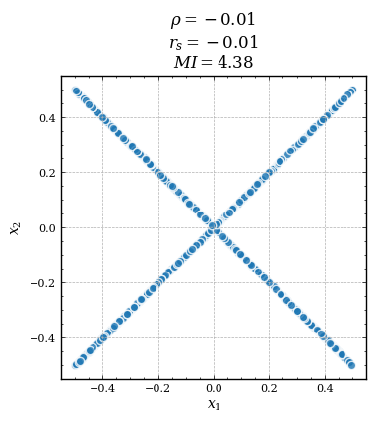
Pearson vs Spearman vs MI

Slide 14



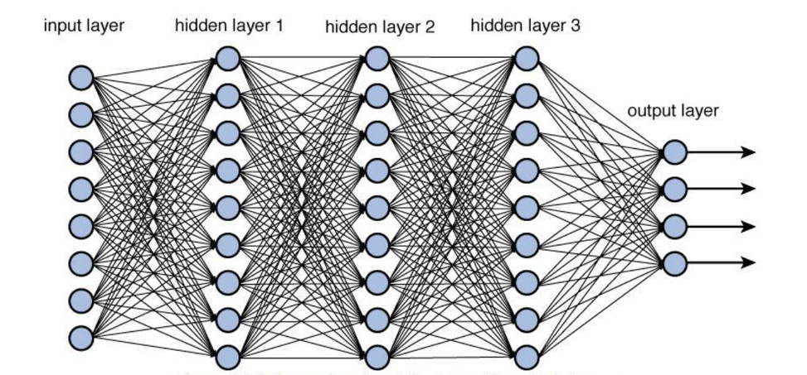
Machine Learning today
Nowadays, the increasing computational power of computing systems and the ever-increasing availability of large datasets (both in terms of observations and covariates), create the perfect environment for exploiting the full potential of highly complex and flexible ML models [1] :
Ensemble methods (e.g., Random Forest, Gradient Boosting) for structured (tabular) data,
Deep Neural Networks for unstructured data (e.g., images, audio signals, …).
Applications:
self-driving cars,
medical diagnosis,
credit risk,
biomedical discoveries,
job candidate screening,
product recommendation,
automatic language translation,
…

Slide 15
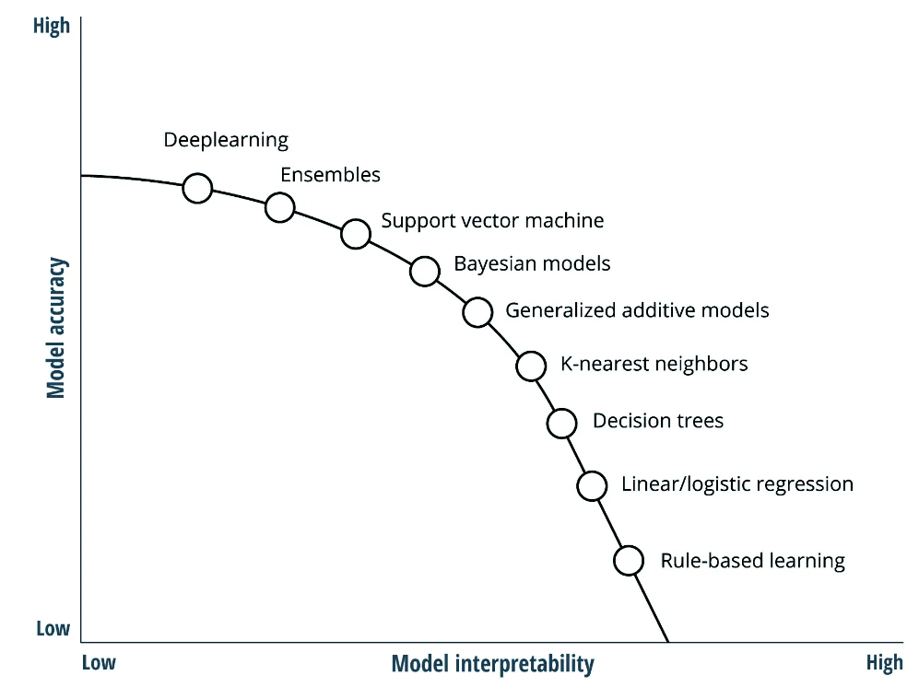











Machine Learning today
Unlike classical statistics, which makes use of intrinsically interpretable models, ML exploits complex and overparameterized models placing greater emphasis on out-of-sample prediction accuracy rather than on the interpretability of the final model.
For this reason, ML is perceived as a black-box methodology that lacks transparency [1].
Accuracy / Interpretability trade-off
Classical statistics
Linear model
Machine Learning
Complex black-box model
$$\begin{matrix}x_{1} \\ \begin{matrix}x_{2} \\ \begin{matrix}⋮ \\ x_{d}\end{matrix}\end{matrix}\end{matrix}$$
$$β_{1}$$
$$\begin{matrix}x_{1} \\ \begin{matrix}x_{2} \\ \begin{matrix}⋮ \\ x_{d}\end{matrix}\end{matrix}\end{matrix}$$
$$f(·)$$
$$β_{2}$$
$$\hat{y}$$
$$\hat{y}$$
$$β_{d}$$
$d$ low
$d$ very high
Source: https://www2.deloitte.com/za/en/insights/industry/financial-services/explainable-ai-in-banking.html

Slide 16
Accuracy vs interpretability
Unlike classical statistics, which makes use of intrinsically interpretable models, ML exploits complex and overparameterized models placing greater emphasis on out-of-sample prediction accuracy rather than on the interpretability of the final model.
For this reason, ML is perceived as a black-box methodology that lacks transparency [1].
Accuracy / Interpretability trade-off
Classical statistics
Linear model
Machine Learning
Complex black-box model
$$\begin{matrix}x_{1} \\ \begin{matrix}x_{2} \\ \begin{matrix}⋮ \\ x_{d}\end{matrix}\end{matrix}\end{matrix}$$
$$β_{1}$$
$$\begin{matrix}x_{1} \\ \begin{matrix}x_{2} \\ \begin{matrix}⋮ \\ x_{d}\end{matrix}\end{matrix}\end{matrix}$$
$$f(·)$$
$$β_{2}$$
$$\hat{y}$$
$$\hat{y}$$
$$β_{d}$$
$d$ low
$d$ very high
Source: https://www2.deloitte.com/za/en/insights/industry/financial-services/explainable-ai-in-banking.html

Slide 17
Accuracy vs interpretability
Would you trust more:
a simple, interpretable but low accurate model
a complex, very accurate but not interpretable model
Why not try to make a black-box model more explainable?

Slide 18












Interpretability in Machine Learning
A (non-mathematical) definition of interpretability [2]:
«Interpretability is the degree to which a human can understand the cause of a prediction of a model.»
The focus is shifted from what a model predicts to why the model generated that particular prediction [1].
ML Explainability: new discipline that aims to make black box models more interpretable.
Explanation
Variable that contributed most to
the model decision
Loan applicant
Features $x$
Machine Learning model
$${ φ_{1}(x}_{1})$$
Personal data
$$\begin{matrix}x_{1} \\ \begin{matrix}x_{2} \\ \begin{matrix}⋮ \\ x_{d}\end{matrix}\end{matrix}\end{matrix}$$
$$f(·)$$
$\hat{y}=$ refused
$${ φ_{2}(x}_{2})$$
Probability of honoring the loan
Education level
$\hat{y}=$ refused
$${ φ_{d}(x}_{d})$$
Employment status
Credit history
P
F
G
E
Loan data
Credit score
Banker
Loan applicant
ML expert

Slide 19
Interpretability in Machine Learning
When and why is needed:
Medium to high-risk environments where a prediction error can have serious consequences (e.g., self-driving cars, medical diagnosis, ...).
Understanding the decisions of complex models can lead to new scientific discoveries [3].
Provides business value by ensuring a technical team, being able to explain model decisions, can communicate more effectively with the business team [4].
It can help companies and institutions to build trust and adoption for customers, regulators and the general public [4].
Legal requirements [5]. Explainability obligations depend on who makes the decisions (e.g., requirements are stronger for public authorities than for private firms), and on the degree of automation of the decision-making process (i.e., when no humans are in the loop).
Four level of constraints on explainability:
providing the main features used to make a decision,
providing all the processed features,
providing a comprehensive explanation of the decision,
providing an understandable representation of the whole model.

Slide 20
Feature selection
A fundamental step to make a complex black-box model more interpretable is that of feature selection.
Feature selection, also known as variable selection, is the process of selecting a subset of relevant features for use in model construction.
Feature selection techniques are used for several reasons:
simplification of models to make them easier to interpret by researchers/users [6],
shorter training times [7],
to avoid the curse of dimensionality [8],
reduce chances of overfitting [9].
In contexts where interpretability is needed, feature selection techniques are based on the estimated importance of individual features.

Slide 21
Feature importance
Feature importance techniques are used to assign an importance value to the single input features, i.e., the impact that the considered feature has on the predictions.
Famous feature importance methods:
Linear model coefficients,
Mean Decrease in Impurity (MDI),
Permutation Feature Importance (PFI),
SHapley Additive exPlanations (SHAP).
Critical points:
Overestimating the importance of irrelevant features can lead to false conclusions.
Underestimating the importance of relevant features can cause such variables to be discarded in the feature selection phase with negative consequences on performance and final interpretation.

Slide 22
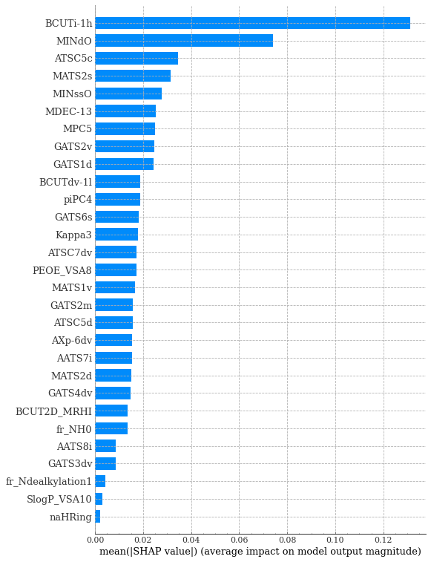
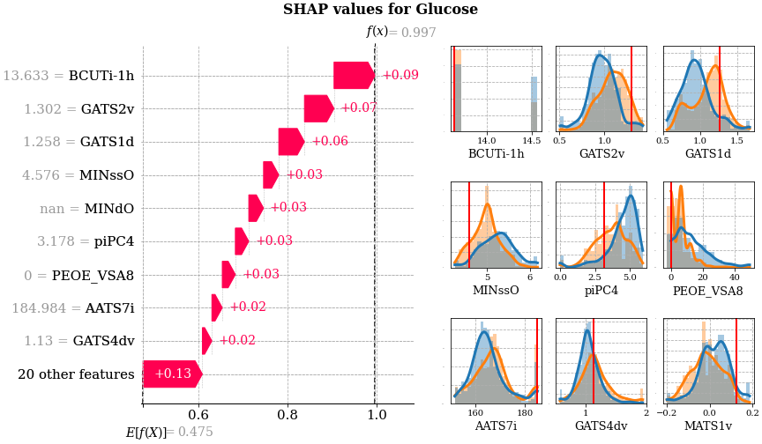
Feature importance
Feature importance can be computed globally on the entire dataset, or locally for single observations of the dataset.
Global feature importance
Local feature importance

Slide 23

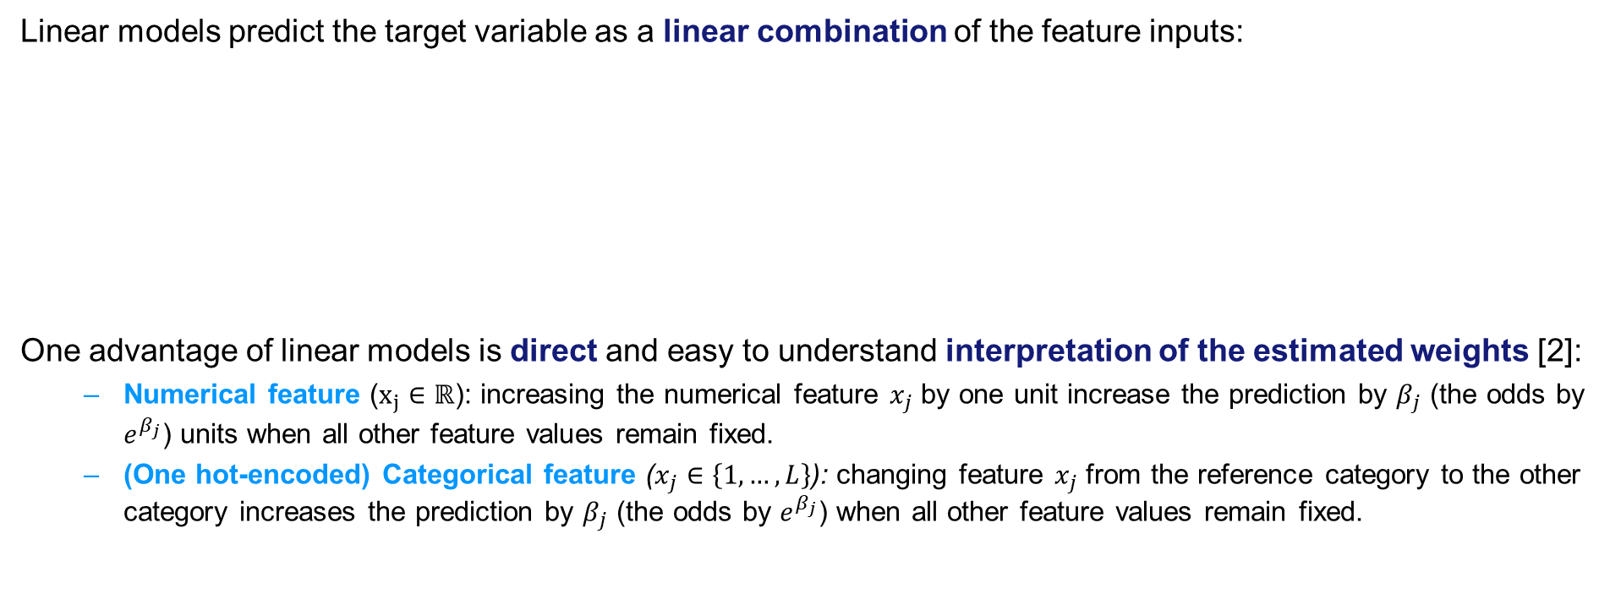
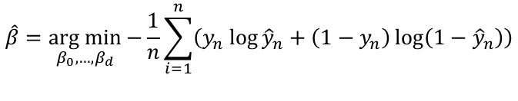
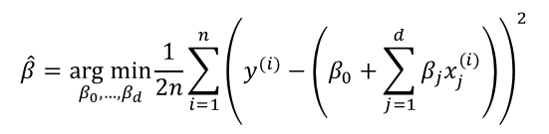
Linear model coefficients
Linear models predict the target variable as a linear combination of the feature inputs:
One advantage of linear models is direct and easy to understand interpretation of the estimated weights [2]:
Numerical feature ($x_{j}∈ℝ$): increasing the numerical feature $x_{j}$ by one unit increase the prediction by $β_{j}$ (the odds by $e^{β_{j}}$) units when all other feature values remain fixed.
(One hot-encoded) Categorical feature ($x_{j}∈\left\{1,…,L\right\}$): changing feature $x_{j}$ from the reference category to the other category increases the prediction by $β_{j}$ (the odds by $e^{β_{j}}$) when all other feature values remain fixed.
Linear regression
Logistic regression
$$\hat{y}\left(x;β\right)=β_{0}+β_{1}x_{1}+…+β_{d}x_{d}$$
$\hat{y}\left(x;β\right)=P\left(y=1|x;β\right)=σ\left(β_{0}+β_{1}x_{1}+…+β_{d}x_{d}\right)$
Mean Squared Error (MSE) loss
Binary cross-entropy loss
$$\hat{β}=\underset{β_{0},…,β_{d}}{arg min}{\frac{1}{2n}\sum_{i=1}^{n}{{\left(y^{(i)}−\left(β_{0}+\sum_{j=1}^{d}{β_{j}x_{j}^{(i)}}\right)\right)}^{2}}}$$
$$\hat{β}=\underset{β_{0},…,β_{d}}{arg min}{−\frac{1}{n}\sum_{i=1}^{n}{\left(y_{n}\log{{\hat{y}}_{n}+\left(1−y_{n}\right)\log\left(1−{\hat{y}}_{n}\right)}\right)}}$$

Slide 24
Linear model coefficients
Prediction accuracy and reliability of the estimated model coefficients depends on certain assumptions [2]:
Linearity: the prediction is forced to be a linear combination of the input features, but the real target could be an arbitrary non-linear function of the inputs. Nevertheless, linear effects being additive, are easily separable and quantifiable and therefore interpretable.
Normality: it is assumed that the target variable, given the features, follows a normal distribution.
Homoscedasticity: the variance of the errors does not depend on the values of the predictor variables.
Indipendence: It is assumed that each instance is indipendent from each other.
Absence of multicollinearity: it is assumed that the features are not strongly linearly correlated because, being the feature contribution to the prediction additive, it becomes indeterminable to which of the correlated feature to attribute the real contribution (*).
(*) DEMO: 0_Linear_model_coeff.ipynb

Slide 25
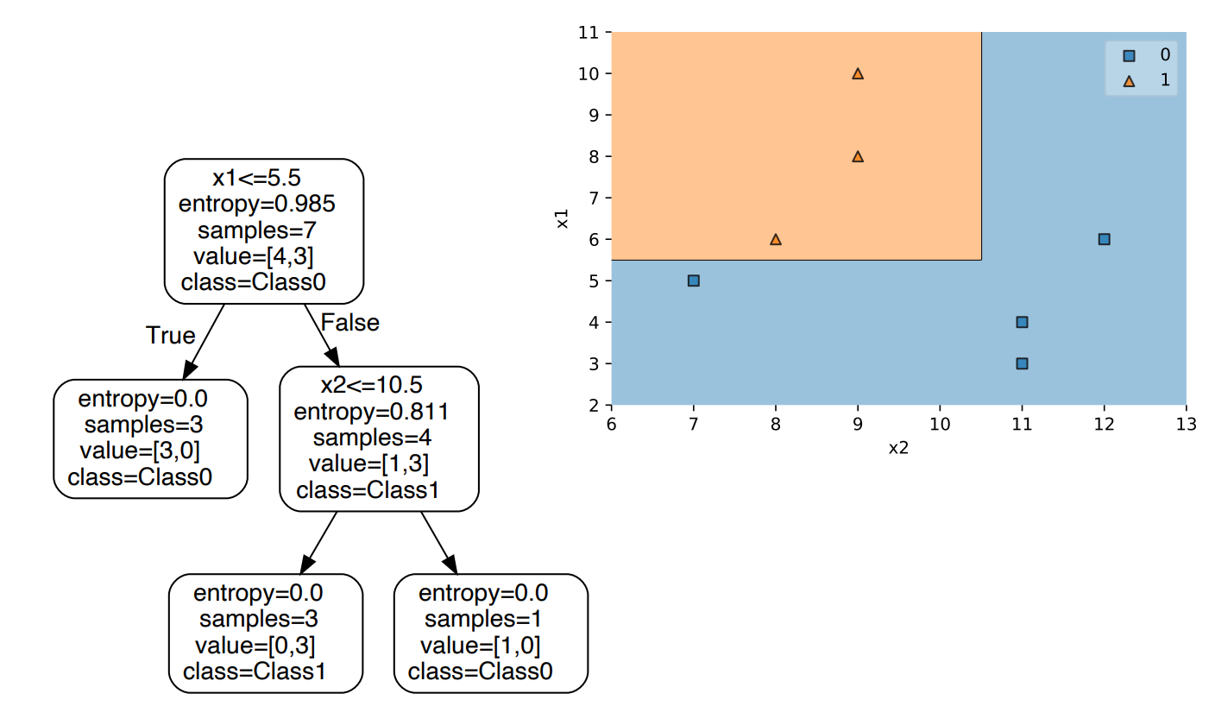
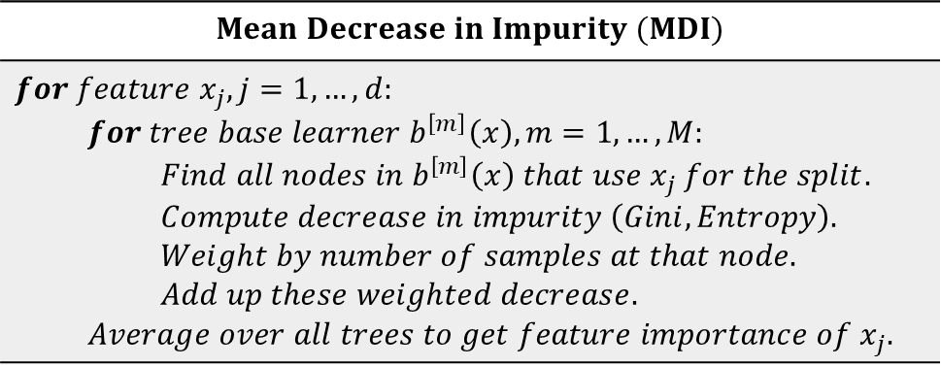
Random Forest feature importance
Model based on decision trees perform feature selection implicitly during the learning phase so that computing feature importance comes at almost no cost [10].
Source: https://sebastianraschka.com/pdf/lecture-notes/stat451fs21/13_feat-sele__slides.pdf

Slide 26
Random Forest feature importance
Drawbacks of impurity-based importances:
biased towards high cardinality features (*),
are computed on in-sample data and therefore are prone to overfitting,
correlated features share importance, therefore their relevance may be underestimated (substitution effect).
(*) DEMO: 1_RF_feature_importance.ipynb

Slide 27
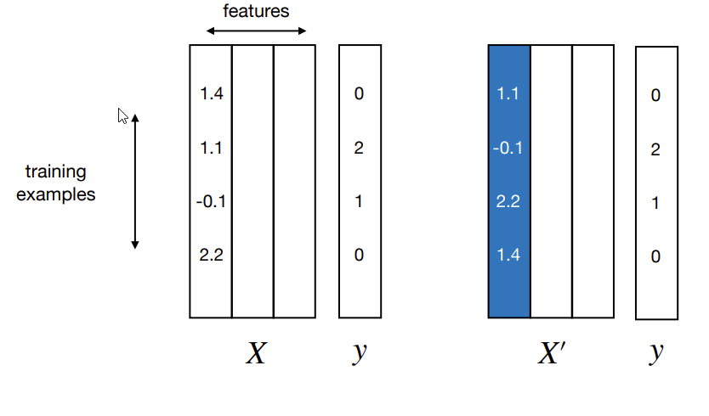
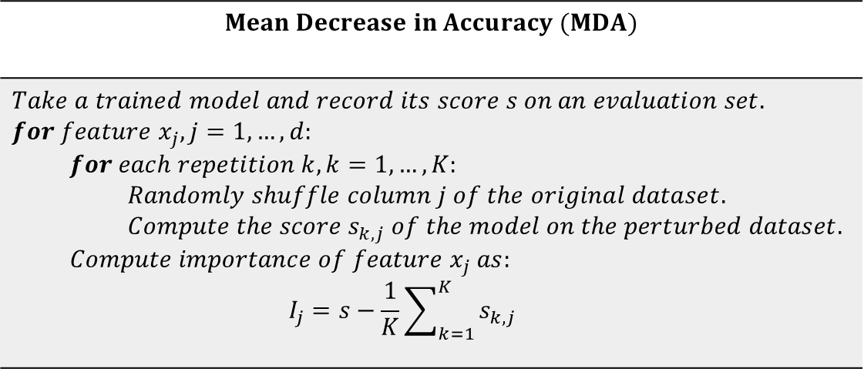
Permutation feature importance (PFI)
PFI is a model interpretation technique that can be used for any model regardless of their complexity and therefore it is very useful in the case of black-box algorithms.
It is defined as the decrease in the considered performance metric when a single feature is randomly shuffled [11]. To get a more robust estimate of the importance the shuffling can be repeated multiple times.
Source: https://sebastianraschka.com/pdf/lecture-notes/stat451fs21/13_feat-sele__slides.pdf
Shuffling a feature breaks its relationship with the target variable, thus the drop in the score reflects how much the model depends on the feature.

Slide 28



Permutation feature importance (PFI)
Pros and cons of PFI:
+ model agnostic,
+ not biased towards high cardinality features,
+ based on a metric of choice,
+ it can be computed on out-of-sample data,
- shuffling columns can produce irrealistic samples if features are dependent:
- correlated features share importance, therefore their relevance may be underestimated (substitution effect) (*).
$x_{1}$- Age class | $x_{2}$ - Weight [kg] | $y$ - hypertension risk
infant | 5 | low
teenager | 75 | low
middle-aged | 85 | high
$x_{1}$- Age class | $x_{2}$ - Weight [kg] | $y$ - hypertension risk
infant | 85 | low
teenager | 75 | low
middle-aged | 5 | high
Shuffle $x_{2}$
(*) DEMO: 2_Permutation_feature_importance.ipynb

Slide 29


Clustered feature importance (CFI)
Apply a single-linkage agglomerative clustering algorithm on a distance matrix with elements [12]:
$$d_{i,j}=\sqrt{\frac{1}{2}\left(1−ρ_{i,j}\right)}$$
where $ρ_{i,j}$ is a some measure of correlation between
feature $x_{i}$ and feature $x_{j}$:
Pearson correlation: for linear dependence,
Spearman correlation: for monotonic dependence,
Mutual information: for general dependence.
…
Then 2 strategies are possible:
instead of shuffling each variable individually, all the features inside a cluster can be shuffled together,
pick one features for each cluster and perform PFI (*).
(*) DEMO: 3_Clustered_feature_importance.ipynb

Slide 30
References
[1] Su-In Lee. “Lecture 1: Introduction” CSEP 590B Explainable AI, University of Washington, Seattle, Spring 2022.
[2] Molnar, Christoph. Interpretable machine learning. Lulu. com, 2020.
[3] Dybowski, Richard. "Interpretable machine learning as a tool for scientific discovery in chemistry." New Journal of Chemistry 44.48 (2020): 20914-20920.
[4] https://www.mckinsey.com/capabilities/quantumblack/our-insights/why-businesses-need-explainable-ai-and-how-to-deliver-it
[5] Bibal, Adrien, et al. "Legal requirements on explainability in machine learning." Artificial Intelligence and Law 29.2 (2021): 149-169.
[6] James, Gareth, et al. An introduction to statistical learning. Vol. 112. New York: springer, 2013.
[7] Wang, Suhang, Jiliang Tang, and Huan Liu. "Feature Selection." (2017): 503-511.
[8] Kramer, Mark A. "Nonlinear principal component analysis using autoassociative neural networks." AIChE journal 37.2 (1991): 233-243.
[9] Kuhn, Max, and Kjell Johnson. Feature engineering and selection: A practical approach for predictive models. CRC Press, 2019.
[10] L. Breiman, “Random Forests”, Machine Learning, 45(1), 5-32, 2001.
[11] https://scikit-learn.org/stable/modules/generated/sklearn.inspection.permutation_importance.html#sklearn.inspection.permutation_importance
[12] López de Prado, Marcos and López de Prado, Marcos, Clustered Feature Importance (Presentation Slides) (January 29, 2020). Available at SSRN: https://ssrn.com/abstract=3517595 or http://dx.doi.org/10.2139/ssrn.3517595

